Slide 1
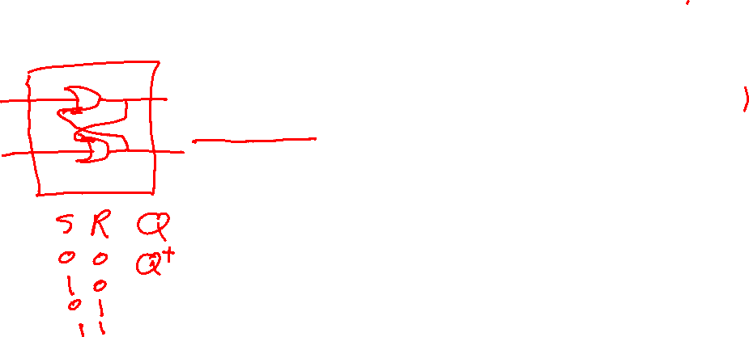
CSE 232
CSE 232 Computer Systems Fundamentals
Dr. Gamal Fahmy
Latches and Flip Flops

Slide 2

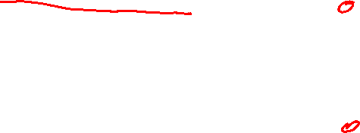
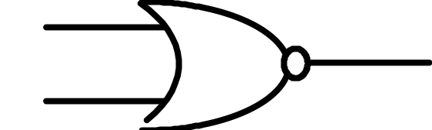
Sequential Circuits
Combinational Logic Circuits: Present State (output) depends only on present value of the inputs.
Sequential Circuits: Present State depends on the present input AND previous state.
R
S
© Gamal Fahmy

Slide 3
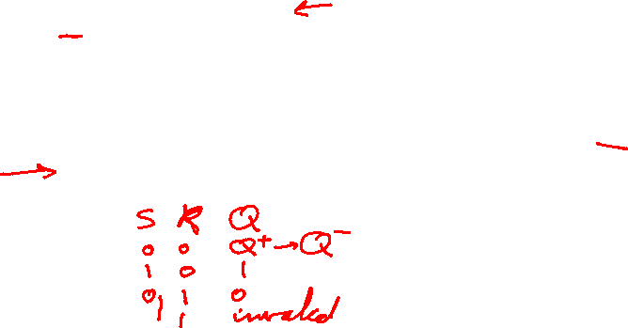
Latches
Latch- a storage device with one input used for storing a “1” and one input used to store a “0”.
Q (State) is the stored output of the device.
R
Q
Reset (R) input resets the state to “0”.
Q
S
Set (S) input sets the state to “1”.
© Gamal Fahmy

Slide 4
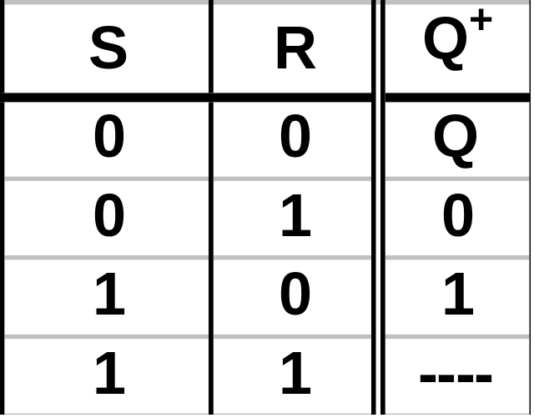
Latches
Let:
  Q= Present State of the device
  Q⁺ = Next State Of the device
Let’s show that the static device characteristics are as follows:
R
Q
Q
S
Invalid State
© Gamal Fahmy

Slide 5

Latches
1
0=
R
Q
=0
1
0
S->1,
S->0,
R->1,
S->1
Q
=1
0
1
0
1
0
1
0=
S
Start in a state of “0.”
Assume R=S=0 initially.
Assume gate delay = 0.
Storing
“0”
Writing
“1”
Storing
“1”
Writing
“0”
R
T
S
Gate Delay
Q
Q
Gate Delay
Timing Diagram
© Gamal Fahmy

Slide 6
Latches
The devices we’ve built are asynchronous devices.
Defn: An asynchronous device has outputs which change independent of any synchronizing clock signal.
Defn: A clock signal is any periodic signal used for synchronizing the change of state of other devices.
© Gamal Fahmy

Slide 7
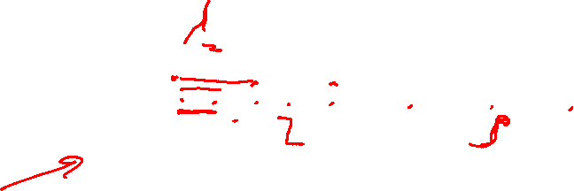
Latches
Clock
T
T=0
Defn: Clock event - clock signal transition (L->H, H->L)
Defn: A synchronous device is any device capable of being synchronized with a clock signal.
Why is a synchronous device desirable?
How can we build a synchronous latch?
© Gamal Fahmy

Slide 8
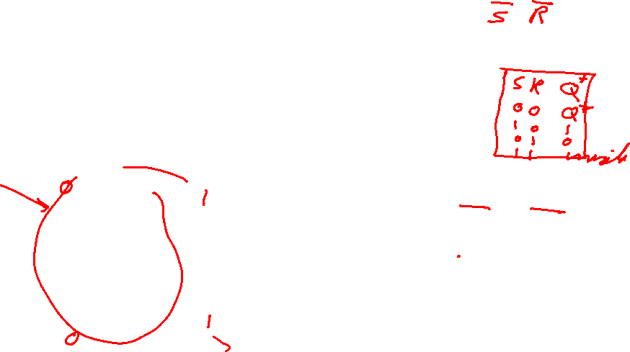
Latches
This is how to build an active high synchronous RS latch.
S
S
S
Clk
R
Q
Q
Q
Clock
RS
Flip Flop
Q
R
R
When clock is high, operates as active high.
When clock is low, R=S=1, Q⁺=Q
© Gamal Fahmy

Slide 9
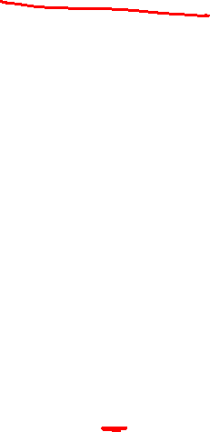
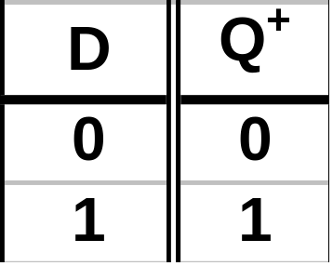
Latches
A flip flop is a latch with a synchronizing input.
Q: How can we avoid the invalid state?
A: Make it into a Data (D) flip flop.
Truth Table for D Flip Flop
D
S
Clk
R
Q
Q
Q
Q
D
Clk
D
Flip Flop
RS
Flip Flop
© Gamal Fahmy

Slide 10
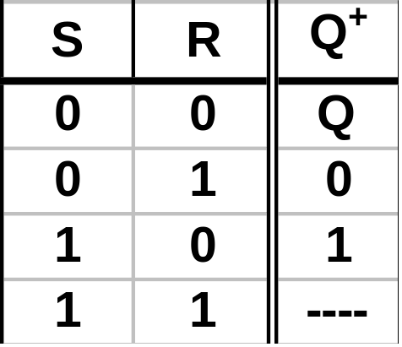

Flip Flops
We started by looking at(asynchronous)latches.
A latch with synchronizing input we called a flip flop.
So far we’ve looked at two types of flip flops.
Truth Table for RS Flip Flop
Truth Table for D Flip Flop
S
Clk
R
Q
Q
Q
Q
D
Clk
D
Flip Flop
RS
Flip Flop
© Gamal Fahmy

Slide 11
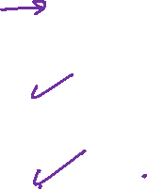
Flip Flops
There are three types of triggering.
  Level Triggered: Flip can only change state when the clock input is at a specific logic level.
  Positive Edge Triggered: Flip flop changes state on the rising (leading) edge of the clock.
  Negative Edge Triggered: Flip flop changes state on the falling (trailing) edge of the clock.
Rising (Leading) Edge
Falling (Trailing) Edge
Clock
T
T=0
© Gamal Fahmy

Slide 12

Flip Flops
Different triggering types are indicated by different symbols on the clock input.
Level
Positive Edge
Negative Edge
Q
Q
Q
Q
Q
Q
D
Clk
D
Clk
D
Clk
D
Flip Flop
D
Flip Flop
D
Flip Flop
© Gamal Fahmy

Slide 13
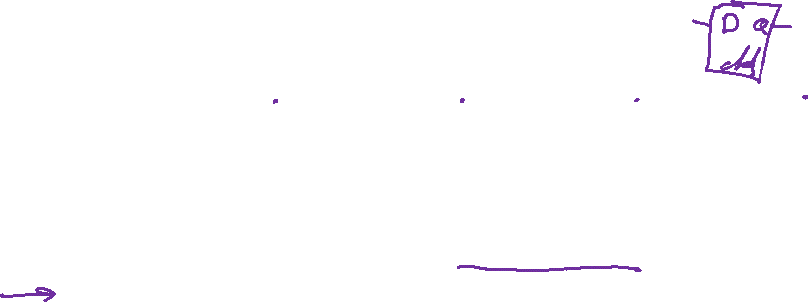
Flip Flops
Examine the response of each triggering type to the same input.
Clk
D
Q_{Level}
Q_{+ve edge}
Q_{-ve edge}
© Gamal Fahmy

Slide 14
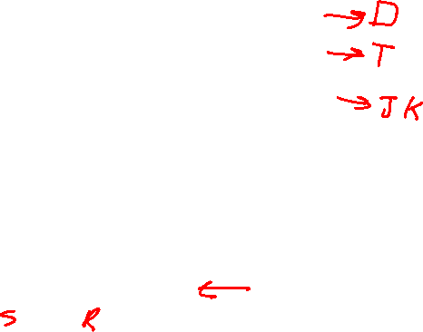
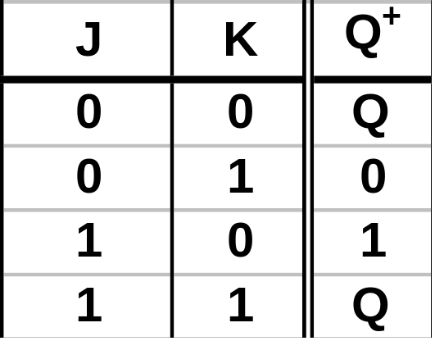
Flip Flops
The most universal is the JK Flip Flop.
Truth Table for JK Flip Flop
J
Clk
K
Q
Q
JK
Flip Flop
This looks like an active-high RS flip flop with J similar to S, K similar to R but with the invalid state removed. J=K=1 Toggles.
© Gamal Fahmy

Slide 15
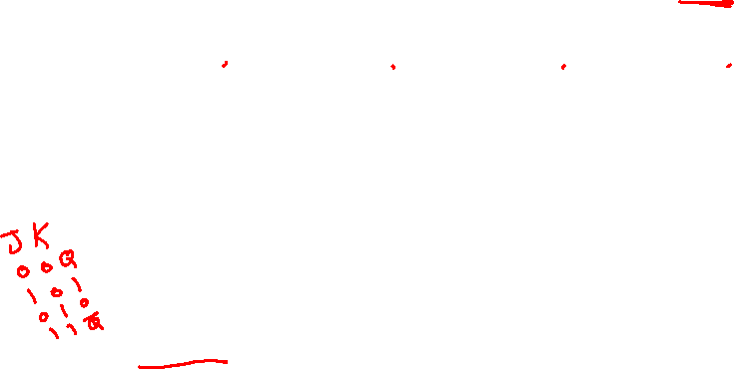
Flip Flops
Look at a timing diagram for a positive-edge triggered JK Flip Flop.
Clk
`
J
K
Q
Toggles
© Gamal Fahmy

Slide 16

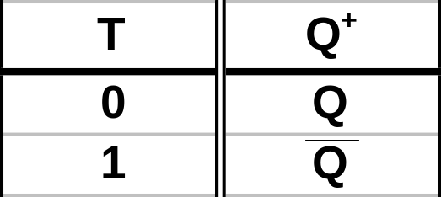
Flip Flops
? Trigger
The Toggle (T) Flip Flop.
Q
Q
T
Clk
T
Flip Flop
Clk
T
Q
Toggles
Toggles
© Gamal Fahmy

Slide 17
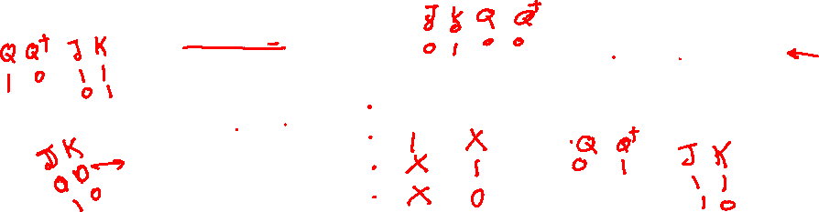
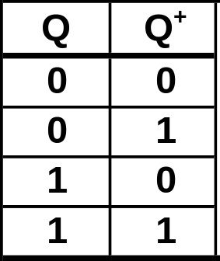

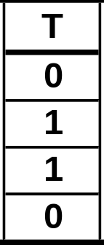
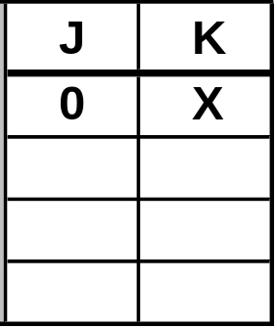

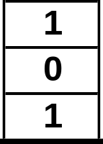
Flip Flops
We’ll need the flip-flop truth tables in another form when we design synchronous sequential machines.
Excitation Table.
© Gamal Fahmy

Slide 18
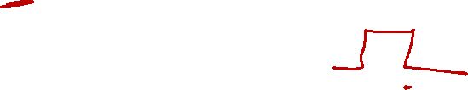
Master and Slave
Q
Q
Q
Q
D
Clk
D
Clk
D
Flip Flop
D
Flip Flop
© Gamal Fahmy

